Slide 1
A Gentle Introduction to Cloud Computing
Dr. Noman Islam

Slide 2
Computing in 21st Century
In 1969, Leonard Kleinrock, (ARPANET Chief Scientist) said:
“… we will probably see the spread of ‘computer utilities’ {5th utility} which, like present electric and telephone utilities, will service individual homes and offices across the country …” (Buyya et al. 09)

Slide 3
Historical Perspectives
Cloud Computing has been around for many years but the term becomes popular when in 2007, Google and IBM announces collaboration (http://www-03.ibm.com/press/us/en/pressrelease/22414.wss)
Following this, IBM announced the Blue Cloud effort (http://www-03.ibm.com/press/us/en/pressrelease/22613.wss)

Slide 4
Cloud Computing (Definition)
"A Cloud is a type of parallel and distributed system consisting of a collection of inter-connected and virtualized computers that are dynamically provisioned and presented as one or more unified computing resources based on service-level agreements established through negotiation between the service provider and consumers.” (Buyya et al. 09)

Slide 5
Cloud Computing (definition)
Cloud computing is an information technology (IT) paradigm that enables ubiquitous access to shared pools of configurable system resources and higher-level services that can be rapidly provisioned with minimal management effort, often over the Internet.

Slide 6
Cloud computing (definition)
“The concept, quite simply, is that vast computing resources will reside somewhere out there in the ether (rather than in your computer room) and we'll connect to them and use them as needed."
- Jonathan Weber (The Times Online)

Slide 7
Why cloud?
Third-party clouds enable organizations to focus on their core businesses instead of expending resources on computer infrastructure and maintenance.
Advocates note that cloud computing allows companies to avoid or minimize up-front IT infrastructure costs
Cloud providers typically use a "pay-as-you-go" model, which can lead to unexpected operating expenses if administrators are not familiarized with cloud-pricing models

Slide 8
Characteristics
Illusion of infinite computing resources available on demand
Ability to pay for use of computing resources on a short-term basis as needed
A style of computing in which dynamically scalable and virtualized resources are provided as a service over the Internet.
Users need not have knowledge of, expertise in, or control over the technology infrastructure "in the cloud" that supports them.

Slide 9
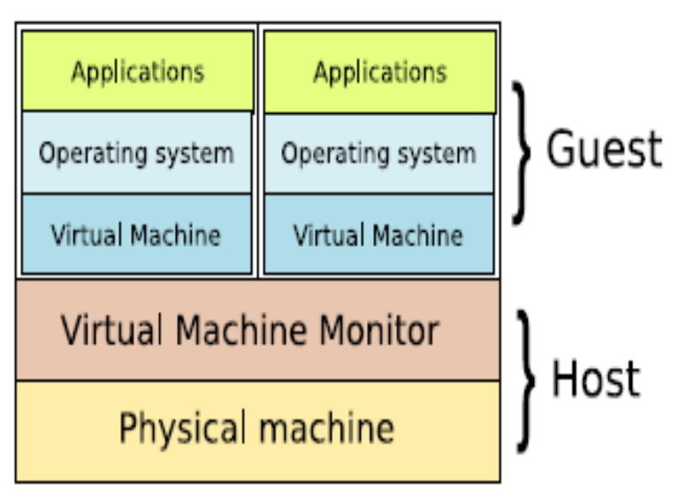
Related terms
Service Oriented Architecture(SOA)
Workflows
Virtualization
  VMWare, Xen
  XenSource

Slide 10
Related terms
Grid Computing
  A form of distributed computing whereby a 'super and virtual computer' is composed of a cluster of networked, loosely coupled computers acting in concert to perform very large tasks - Server Infrastructure
Utility Computing
  packaging of computing resources, such as computation and storage, as a metered service similar to a traditional public utility, such as electricity
Autonomic Computing
  Computer systems capable of self-management
Software-As-A-Service (SaaS)

Slide 11
Virtualization
Virtualization software separates a physical computing device into one or more "virtual" devices, each of which can be easily used and managed to perform computing tasks.
With operating system–level virtualization essentially creating a scalable system of multiple independent computing devices, idle computing resources can be allocated and used more efficiently.
Virtualization provides the agility required to speed up IT operations, and reduces cost by increasing infrastructure utilization.

Slide 12
Hardware virtualization
Hardware virtualization or platform virtualization refers to the creation of a virtual machine that acts like a real computer with an operating system.
Software executed on these virtual machines is separated from the underlying hardware resources.

Slide 13
For example, a computer that is running Microsoft Windows may host a virtual machine that looks like a computer with the Ubuntu Linux operating system; Ubuntu-based software can be run on the virtual machine
The software or firmware that creates a virtual machine on the host hardware is called a hypervisor or Virtual Machine Manager.

Slide 14
Pros & Cons of Cloud
Pros:
  Reduced Cost
  Increased Storage
  Highly Automated
  More Mobility
  More concentration of actual task
Cons:
  Security
  Reliance on 3rd party
  Cost of transition
  Uncertainty of benefits

Slide 15
Cloud Deployment Models
Internal (private) cloud: The cloud infrastructure is operated within the consumer’s organization.
Community cloud: The cloud infrastructure is jointly owned by several organizations and supports a specific community that has shared concerns (e.g., mission, security requirements, policy, and compliance considerations).

Slide 16
Public cloud: The cloud infrastructure is owned by an organization selling cloud services to the general public or to a large industry group.
Hybrid cloud: The cloud infrastructure is a composition of two or more clouds (internal, community, or public) that remain unique entities but are bound together by standardized or proprietary technology that enables data and application portability

Slide 17
Big data cloud
The issues of transferring large amounts of data to the cloud as well as data security once the data is in the cloud initially hampered adoption of cloud for big data, but now that much data originates in the cloud and with the advent of bare-metal servers, the cloud has become a solution for use cases including business analytics and geospatial analysis.
Solutions range from Hadoop hosting in the cloud to end-to-end analytics

Slide 18
HPC cloud
HPC cloud refers to the use of cloud computing services and infrastructure to execute high-performance computing (HPC) applications
These applications consume considerable amount of computing power and memory and are traditionally executed on clusters of computers

Slide 19
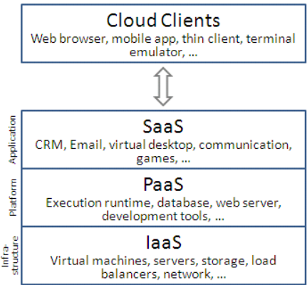
Service Models
Infrastructure-As-A-Service (IaaS)
Platform-As-A-Service(PaaS)
Software-As-A-Service(SaaS)

Slide 20
Infrastructure as a Service
"Infrastructure as a service" (IaaS) refers to online services that provide high-level APIs used to dereference various low-level details of underlying network infrastructure like physical computing resources, location, data partitioning, scaling, security, backup etc.
A hypervisor, such as Xen, Oracle VirtualBox, Oracle VM, KVM, VMware ESX/ESXi, or Hyper-V, LXD, runs the virtual machines as guests

Slide 21
Linux cgroups and namespaces are the underlying Linux kernel technologies used to isolate, secure and manage the containers
Containerisation offers higher performance than virtualization, because there is no hypervisor overhead.
Also, container capacity auto-scales dynamically with computing load, which eliminates the problem of over-provisioning and enables usage-based billing

Slide 22
IaaS clouds often offer additional resources such as a virtual-machine disk-image library, raw block storage, file or object storage, firewalls, load balancers, IP addresses, virtual local area networks (VLANs), and software bundles

Slide 23
Platform as a Service
PaaS vendors offer a development environment to application developers.
In the PaaS models, cloud providers deliver a computing platform, typically including operating system, programming-language execution environment, database, and web server.

Slide 24
Application developers can develop and run their software solutions on a cloud platform without the cost and complexity of buying and managing the underlying hardware and software layers.
With some PaaS offers like Microsoft Azure, Oracle Cloud Platform and Google App Engine, the underlying computer and storage resources scale automatically to match application demand so that the cloud user does not have to allocate resources manually

Slide 25
Software-as-a-Service (SaaS)
In the software as a service (SaaS) model, users gain access to application software and databases.
In the SaaS model, cloud providers install and operate application software in the cloud and cloud users access the software from cloud clients.
Cloud users do not manage the cloud infrastructure and platform where the application runs.

Slide 26
The pricing model for SaaS applications is typically a monthly or yearly flat fee per user
Proponents claim that SaaS gives a business the potential to reduce IT operational costs by outsourcing hardware and software maintenance and support to the cloud provider.

Slide 27
Mobile backend as a Service
In the mobile "backend" as a service (m) model, also known as backend as a service (BaaS), web app and mobile app developers are provided with a way to link their applications to cloud storage and cloud computing services with application programming interfaces (APIs) exposed to their applications and custom software development kits (SDKs).

Slide 28
Services include user management, push notifications, integration with social networking services and more.
This is a relatively recent model in cloud computing, with most BaaS startups dating from 2011 or later but trends indicate that these services are gaining significant mainstream traction with enterprise consumers

Slide 29
Serverless Computing
Serverless computing is a cloud computing code execution model in which the cloud provider fully manages starting and stopping virtual machines as necessary to serve requests, and requests are billed by an abstract measure of the resources required to satisfy the request, rather than per virtual machine, per hour.

Slide 30
Despite the name, it does not actually involve running code without servers.
Serverless computing is so named because the business or person that owns the system does not have to purchase, rent or provision servers or virtual machines for the back-end code to run on

Slide 31
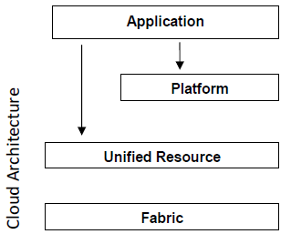
Cloud Architecture

Slide 32
The fabric layer contains the raw hardware level resources, such as compute resources, storage resources, and network resources.
The unified resource layer contains resources that have been abstracted/encapsulated (usually by virtualization) so that they can be exposed to upper layer and end users as integrated resources, for instance, a virtual computer/cluster, a logical file system, a database system, etc.

Slide 33
The platform layer adds on a collection of specialized tools, middleware and services on top of the unified resources to provide a development and/or deployment platform.

Slide 34
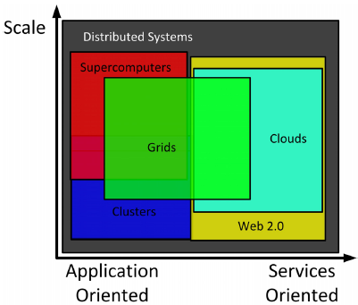
Clouds Vs Grid

Slide 35
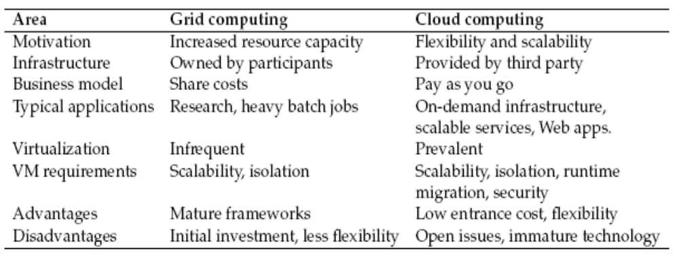
Grid Vs Cloud

Slide 36
Challenges
Construction of services and images for realizing cloud applications
Open Virtualization Format
Provenance Data
Security
  Legal Issues
  Privacy
Job Scheduling

Slide 37
Key players
Amazon Web Servcies
Google Application Engine
Microsoft Windows Azure

Slide 38
Amazon Elastic Compute Cloud (EC2)
Amazon Elastic Compute Cloud (EC2) forms a central part of Amazon.com's cloud-computing platform, Amazon Web Services (AWS), by allowing users to rent virtual computers on which to run their own computer applications.
EC2 encourages scalable deployment of applications by providing a web service through which a user can boot an Amazon Machine Image (AMI) to configure a virtual machine, which Amazon calls an "instance", containing any software desired.

Slide 39
A user can create, launch, and terminate server-instances as needed, paying by the second for active servers – hence the term "elastic".
EC2 provides users with control over the geographical location of instances that allows for latency optimization and high levels of redundancy

Slide 40
Features
Operating systems
Persistent storage
  The Amazon Elastic Block Store (EBS) provides raw block devices that can be attached to Amazon EC2 instances
  Simple Storage Service (S3) is a storage system in which data is accessible to EC2 instances, or directly over the network to suitably authenticated callers (all communication is over HTTP)

Slide 41
Simple Storage Service (S3) is a storage system in which data is accessible to EC2 instances, or directly over the network to suitably authenticated callers (all communication is over HTTP)

Slide 42
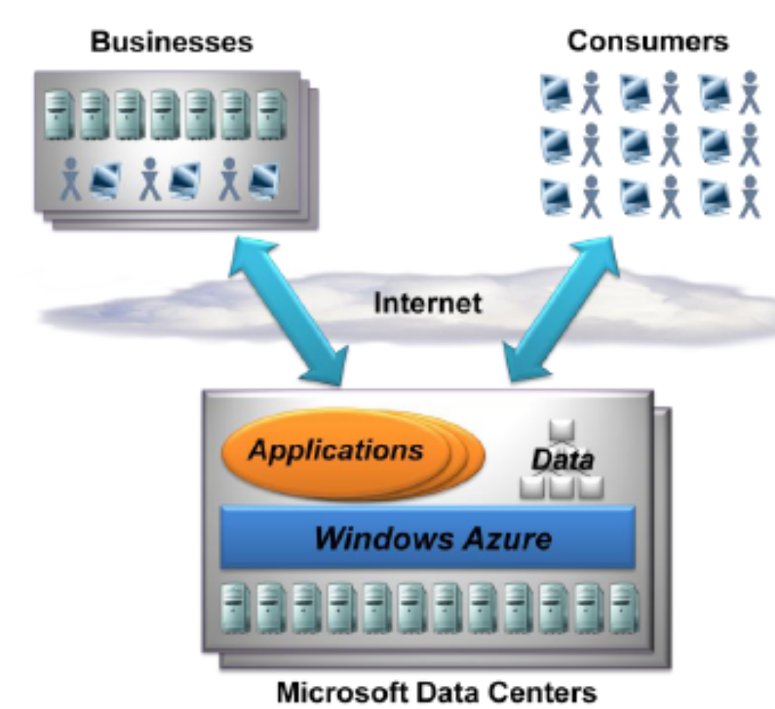
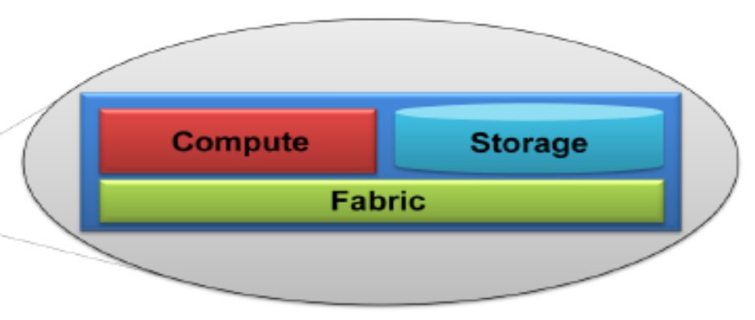
Microsoft Azure

Slide 43
The Compute Service
Primary goal of this platform, however, is to support applications that have a very large number of simultaneous users
A Windows Azure application can have multiple instances, each executing in its own virtual machine (VM). Each VM is provided by a hypervisor (based on Hyper-V)
Instance Roles
  Web Roles (ASP .NET, WCF, PHP, JSP etc.)
  Worker Roles (background job)

Slide 44
Storage Service
BLOB
Tables
Queues

Slide 45
Google Application Engine
Google AppEngine is a PaaS offering from Google
AppEngine only supports applications written in the Java or Python languages
Developers designing systems for AppEngine download a Software Development Kit (SDK) containing libraries and software enabling applications to be developed and run locally, emulating the services available in the AppEngine cloud environment.
To deploy a system on the AppEngine cloud, developers use a custom upload tool provided by Google along with aWeb-based control interface.

